Slide 1
DSI Project 1
SAT vs ACT participation and scores, Analysis

Slide 2
Problem Statement
Analysing the participation rates and scores of SAT and ACT, this report seeks to identity the reasons for the fluctuation of the SAT and ACT participation within US states. Using these reasons, the aim of this report is to recommend strategies to improve participation rates in at least 1 state

Slide 3
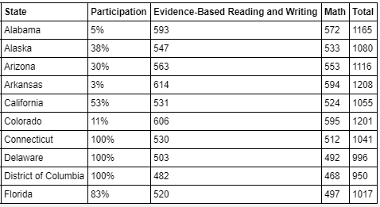
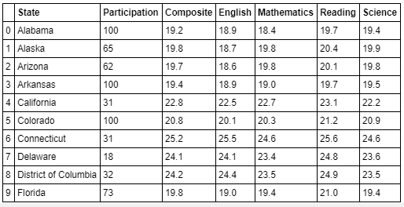
Variables in comparison
2017 SAT & ACT data – 51 states
2017 SAT data
2017 ACT data

Slide 4
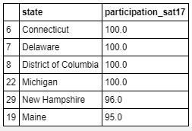
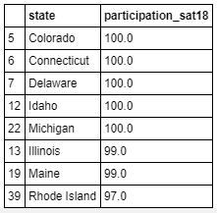
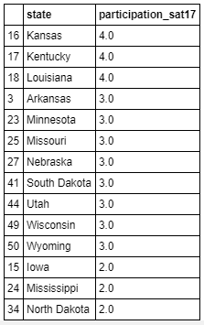
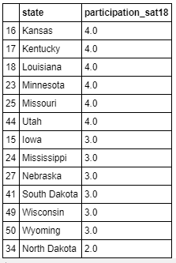
States with highest and lowest Participant % for SAT 2017 vs 2018

Slide 5
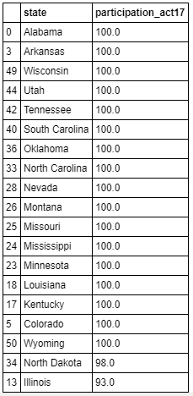
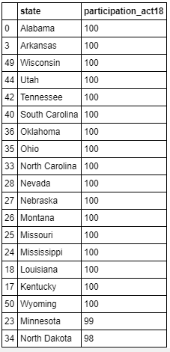
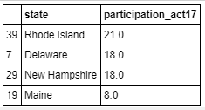
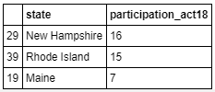
States with highest and lowest Participant % for ACT 2017 vs 2018

Slide 6
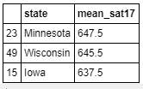
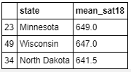
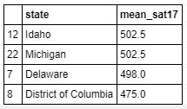
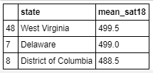
States with highest and lowest mean scores for SAT 2017 vs 2018

Slide 7
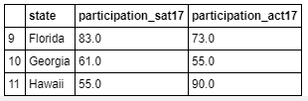
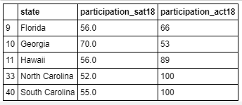
States that show >50% participation on both tests either year

Slide 8
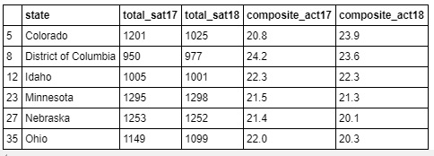
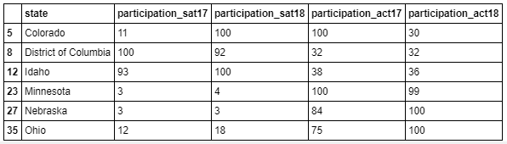
Rate of change participation and scores of 100% participation states
Colorado (4): SAT participation increased significantly fromm 2017 to 2018 while ACT participation reduced significantly
SAT participation rose from 11% to 100%
ACT participation fell from 100% to 30%
Ohio (34): Both ACT and SAT participation rose
SAT: from 75% to 100% within a year
ACT: from 12% to 18%

Slide 9
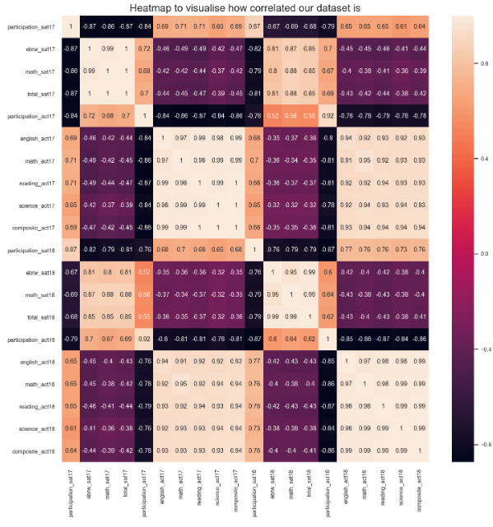
Heatmap
- showing correlation between the variables

Slide 10
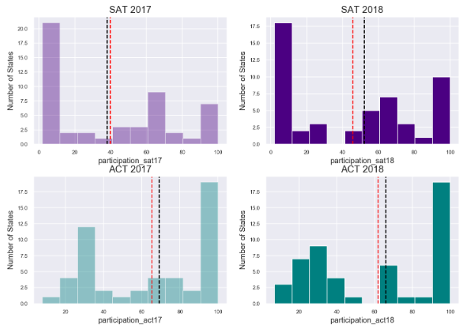
Histogram
Participation for SAT and ACT

Slide 11
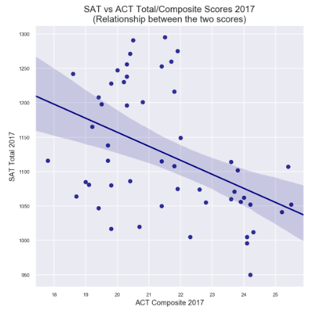
Scatter plot
SAT total vs ACT composite 2017

Slide 12
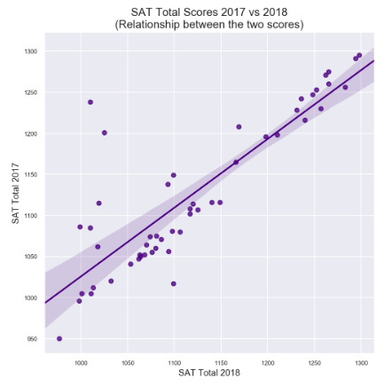
Scatter plot
SAT 2017 vs SAT 2018

Slide 13
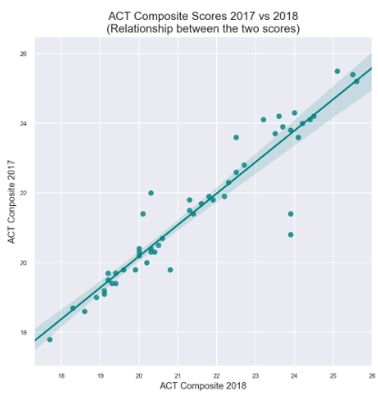
Scatter plot
ACT 2017 vs ACT 2018

Slide 14
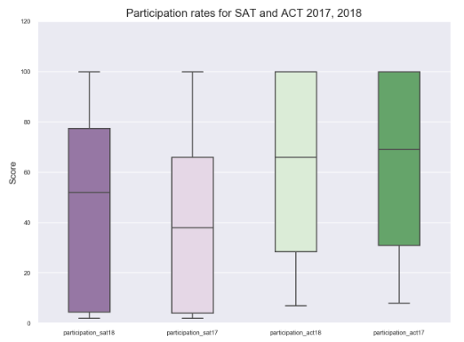
Box plot
Participation for SAT and ACT

Slide 15
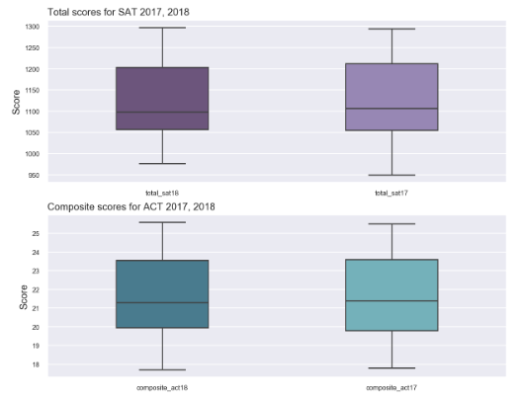
Box plot
Scores for SAT and ACT

Slide 16
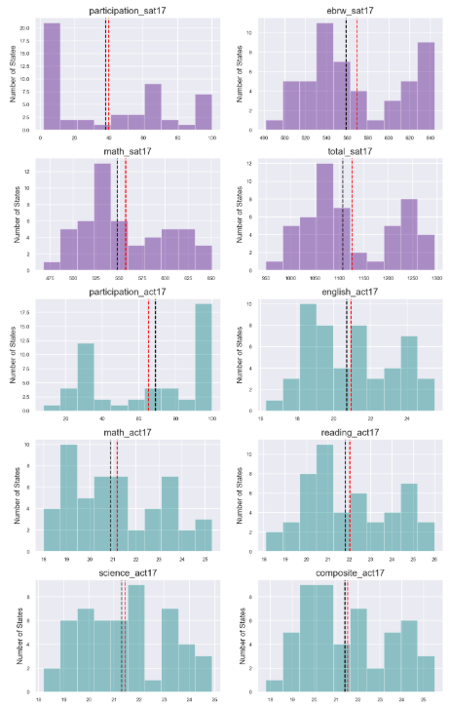
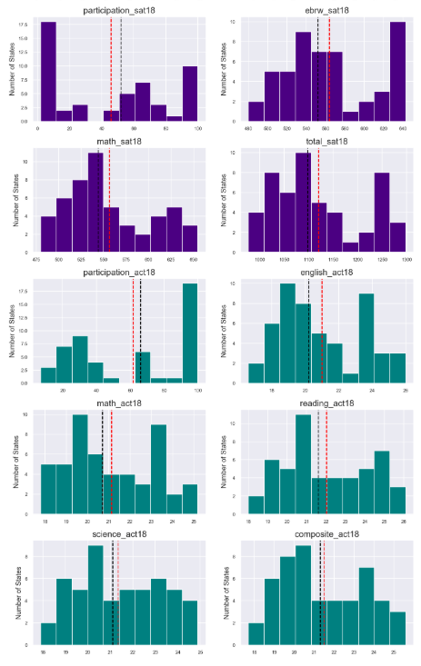
Overall
SKEWNESS:
2017 SAT participation had the greatest positive skew, followed by 2018 SAT participation. Both ACT participation had negative skewness with 2018 ACT participation having a greater skew compared 2017 ACT participation
SPREAD OF DATA, (STANDARD DEVIATION)
2018 SAT participation has the greatest standard deviation, followed by 2017 SAT participation, followed by 2018 ACT participation and 2017 ACT participation having the lowest
SHAPE:
could not be determined. However as number of states/ data points were greater than 30, we can say that the variables will fit into a normal distributions

Slide 17
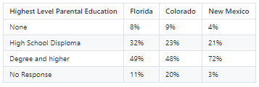
Conclusion and recommendation
Looking at the SAT college board reports, it is safe to conclude that while students from a diverse background took the SAT exams in Florida and Colorado, in New Mexico, only students from families with a good educational background took the text.
College board could target the middle households and promote the fee waiver incentive to students thus increasing the diversity of participants
Since New Mexico is a state where students have the freedom to choose the college exam they prefer, or to skip it altogether, the college board could get the education department to subsidize full costs of the test and thus possibly making it mandatory for all high school students to take it.

